Slide 1
TRAIN TICKET RESETRVATION SYSTEM
NAME : KUPPUSAMY P
DATE: 17\10\2024

Slide 2
Aim of Train Ticket Reservation System:
Simplify the process of booking train tickets.
Provide real-time availability of trains and seats.
Automate ticket generation and minimize manual errors.
Improve efficiency for railway staff and passengers.

Slide 3
BUSINESS PROBLEMS:
Overbooking: Risk of overbooking due to lack of real-time seat availability updates.
Limited Accessibility: Inconvenience for passengers who cannot access booking counters
Payment Issues: Inability to securely handle payments or offer multiple payment methods.

Slide 4
PROJECT DESCRIPTION:
Online Booking Portal: A platform where passengers can search trains, check seat availability, and book tickets.
Ticket Modifications: Allows passengers to cancel or modify bookings as per their need.
By handling errors and exception it bring satisfaction.

Slide 5
FUNCTIONALITY:
View Train information:
Allow to users to easily access the train information in clearly.
Booking train ticket:
Select the train and passenger name.The name of the individual traveling.

Slide 6
INPUT VERSATILITY WITH ERROR AND EXCEPTION HANDLING:
Multiple Input Formats:
User can search trains using various input formats like station name, station train number.
Input Error Handling:
Display clear error messages for incorrect inputs (incorrect station name and incorrect train number).
Exception Handling for system issues:
Catch system errors(server crashes, network issues).

Slide 7
CODE IMPLEMENTATION
Reading a train details from file:
1. Train details menu:
*Booking Ticket
*Cancel Ticket
*View Booked
*Exit
2.Availabilty
*Ask user to booking seats.

Slide 8
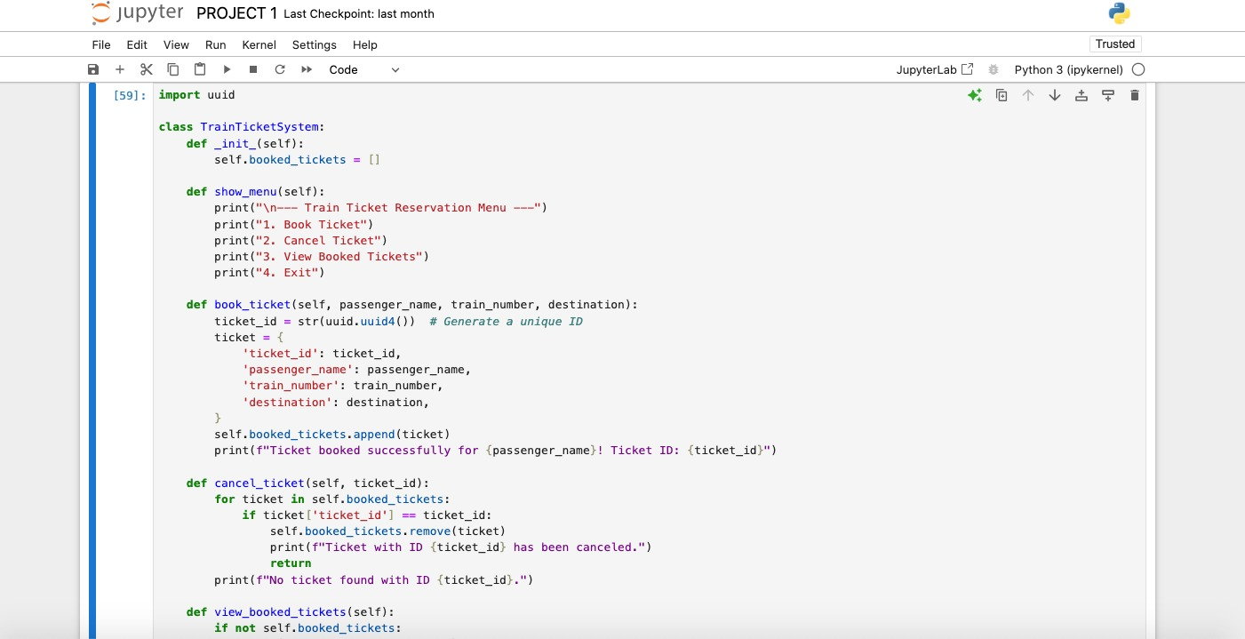
CODE SNIPPET:

Slide 9
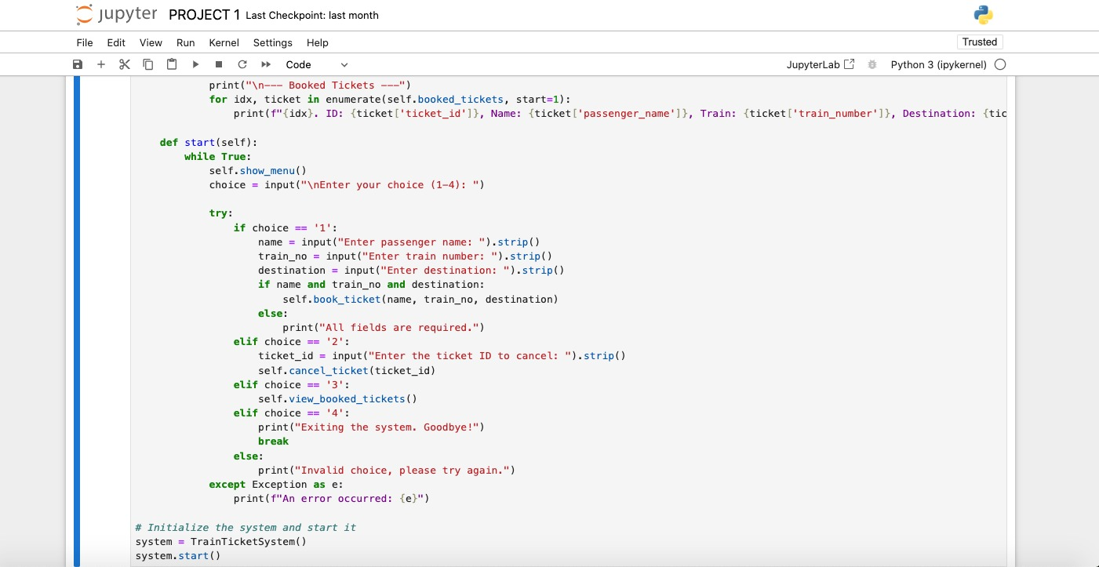
CODE SNIPPET:

Slide 10
RESULT:
Train search and availability:
* Users can search for trains based on departure and arrival stations.
Ticket Booking:
*Users select the train, and number of passengers and booking.
Ticket Cancellation:
*Users can cancel booked tickets within a specified train number and passenger name to cancel ticket.

Slide 11
THANK YOU

